Slide 1

UNIVERSITY OF MESSINA
Department
Cognitive Science and Theory of Communication – LM-55
Course Title
SOCIAL SEMIOTICS
Teacher
Maria Rita Bartolomei
Mail: mabartolomei@unime.it

Slide 2

SOCIAL SEMIOTICS
Sign
the union of a signifier and a signified
Signifier
the observable form of the sign, such as a sound, a word or a colour,
create a communication; the sensory impression of the sign
Signified
the concept that a signifier refers to
it depends on who you are and where you are

Slide 3
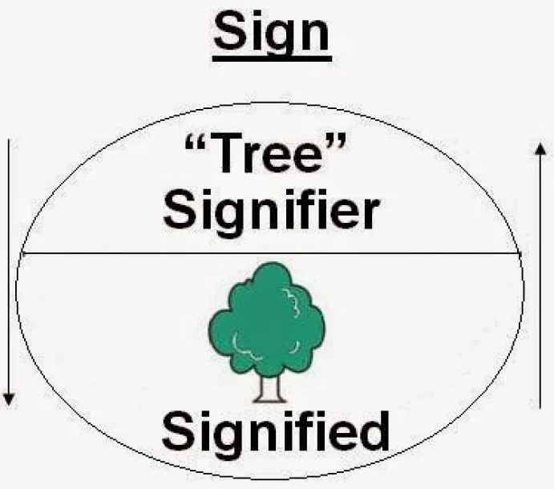
SOCIAL SEMIOTICS
The basic unit of signification is the sign
Signifier: the sound image
Signified: the concept
The relationship is conventional and arbitrary

Slide 4
SOCIAL SEMIOTICS
DENOTATION AND CONNOTATION
Sign
has a referential function
anything which produces meaning and refers to something
Participants in communication
create meanings by making signs

Slide 5
SOCIAL SEMIOTICS
DENOTATION AND CONNOTATION
Denotation and connotation
refer to related concepts
are easily confused

Slide 6
SOCIAL SEMIOTICS
DENOTATION AND CONNOTATION
Denotation and connotation
- both refer to word meanings
but they are very different concepts
What is the difference between denotation and connotation?

Slide 7
SOCIAL SEMIOTICS
DENOTATION AND CONNOTATION
Denotation
It is the literal, explicit or direct meaning of a word
It is the standardized meaning of a word within the language
It is the meaning of a word which everyone agree on

Slide 8
SOCIAL SEMIOTICS
DENOTATION AND CONNOTATION
Proud
Denotation: “having or showing self-respect or self-exteeme”
Vintage:
Denotation: “produced in the past and typical of the period in which
it was made”

Slide 9
SOCIAL SEMIOTICS
CONNOTATION AND DENOTATION
Words can have more than one meaning and even change their meaning
The sign can more accurately be pictured as having a spread of signifieds

Slide 10
SOCIAL SEMIOTICS
DENOTATION AND CONNOTATION
Connotation refers to
the emotions a word evokes
the ideas which you think when you hear or read a word
It is an indirect or implied meaning or feeling
It is much more subjective
It emphasises the plurality of meanings

Slide 11
SOCIAL SEMIOTICS
DENOTATION AND CONNOTATION
Proud
Denotation: “having or showing self-respect or self-exteeme”
Connotation: arrogant, immodest, overbearing, vainglorious (negative meaning);
Self-confidence, glorious, honored, satisfied (positive meaning)
Vintage:
Denotation: “produced in the past and typical of the period in which it was made”
Connotation: an old style which is making a comeback; a nostalgic quality

Slide 12
SOCIAL SEMIOTICS
DENOTATION AND CONNOTATION
Used in this way, connotation emphasises the plurality of the signified
Connotations are a way of generating a spread of signifieds around a given signifier
Mutt: a mixed-breed dog
Denotation: Since he is a mix of beagle and terrier, he's a mutt.
Connotation: That mutt is always barking

Slide 13
SOCIAL SEMIOTICS
The verb denote means: “to indicate” or “to mean”
The verb connote means “to signify or suggest (certain meanings, ideas, etc.)
in addition to the explicit or primary meaning”
Denotation is the standard definition of a word
Connotation is the feeling evoked by a word

Slide 14
SOCIAL SEMIOTICS
Denotation is the plain and direct meaning definition of a word
Connotation is the feelings associated with a word
While the denotation of a word is pretty cut and dry
one word can have many connotations for different people, and those connotations could be neutral, positive, or negative

Slide 15
SOCIAL SEMIOTICS
DENOTATION AND CONNOTATION
Grin, Beam, Sneer, Simper
Denotation: These are all synonyms for smile
Connotation: Both grin and beam have positive connotations and are
generally associated with someone who is genuinely happy
Sneer has a negative connotation and is usually associated
with someone being cruel or scornful
Simper also has a negative connotation but is usually
associated with someone weak or unintelligent

Slide 16
SOCIAL SEMIOTICS
DENOTATION AND CONNOTATION
Connotation of a sign are
the set of its possible signified

Slide 17
SOCIAL SEMIOTICS
DENOTATION AND CONNOTATION
Exercises: write a few sentences with the suggested words
Chicken
Childlike
Dabble
Home
Jabber
Smile
Twinkle
Wave

Slide 18
SOCIAL SEMIOTICS
DENOTATION AND CONNOTATION
Examples
Cheap: to cost very little
Denotation: this shirt is cheap enough for me to afford
Connotation: that t-shirt was so cheap, it pilled in a matter of weeks
Dabble: to show a superficial interest
Denotation: I dabble in painting
Connotation: You should never dabble in drugs

Slide 19
SOCIAL SEMIOTICS
DENOTATION AND CONNOTATION
Note:
A denotation is not the definition you would find in the dictionary, but a word’s primary meaning
A word's connotations may not be commonly held; sometimes a word will have a particular connotation only for a culture, for group of people, for a family, or even for a single person

